Slide 1


Slide 2

Problem Statement
T H E C H A L L E N G E
Hospital data is scattered across separate systems — patient admissions, department capacity, staff schedules, and billing all live in different files, in different formats, updated on different cycles.
1
No unified view
2
Reactive decisions
Administrators cannot see patient flow, staffing, and cost
together in one place.
Without consolidated KPIs, capacity and staffing issues are
noticed after they occur, not before.
3
Manual reporting
4
Limited financial visibility
Comparing department performance or tracking readmissions means manually cross-referencing spreadsheets.
Cost drivers by condition, state, or department are difficult to isolate for budget planning.

Slide 3









Proposed Solution
T H E A P P R O A C H
An end-to-end analytics pipeline that collects, cleans, and merges hospital data in Python, engineers core operational KPIs, and delivers the results as an interactive, filterable dashboard suite — built independently in both Tableau and Power BI — giving administrators one consolidated, real-time view of patient flow, staffing, and finances.
→
→
→
Collect
Clean & Merge
Engineer KPIs
Build Dashboards
5 raw hospital operation files
Pandas / NumPy in Jupyter
LOS, Occupancy, Readmission +
Tableau + Power BI
TOOLS & TECHNOLOGIES
Python
Jupyter
Pandas
Tableau
Power BI

Slide 4
Datasets Used
D A T A C O L L E C T I O N
Hospital Patient.csv
patients.csv
services_weekly.csv
staff.csv
staff_schedule.csv
984 rows × 15 cols
1,000 rows × 7 cols
208 rows × 10 cols
110 rows × 4 cols
6,552 rows × 6 cols
Patient demographics, condition, cost & outcome
Patient visits linked to hospital service
Weekly bed capacity & service demand
Staff roster by role & department
Weekly attendance records
5 raw source files — combining patient-level records with operational (capacity, staffing) data

Slide 5
D A T A P R E P A R A T I O N
Data Cleaning — Before vs. After
BEFORE CLEANING
AFTER CLEANING & MERGING
Hospital Patient
984 × 15
1,000
R O W S
patients
1,000 × 7
→
services_weekly
208 × 10
20
C O L U M N S
staff
110 × 4
staff_schedule
6,552 × 6
5 separate files • inconsistent column names • text-formatted dates
One unified, analysis-ready dataset — zero nulls, zero duplicates

Slide 6

Hospital KPIs Engineered
F R O M D A T A T O I N S I G H T
Total Admissions
Avg. Length of Stay
Bed Utilization Rate
Distinct patient count
37.7 days
91.95% overall
Occupancy Rate
Readmission Rate
Service-Level KPIs
Admitted ÷ Available beds
Repeat-visit patients ÷ total
Per-department comparison

Slide 7

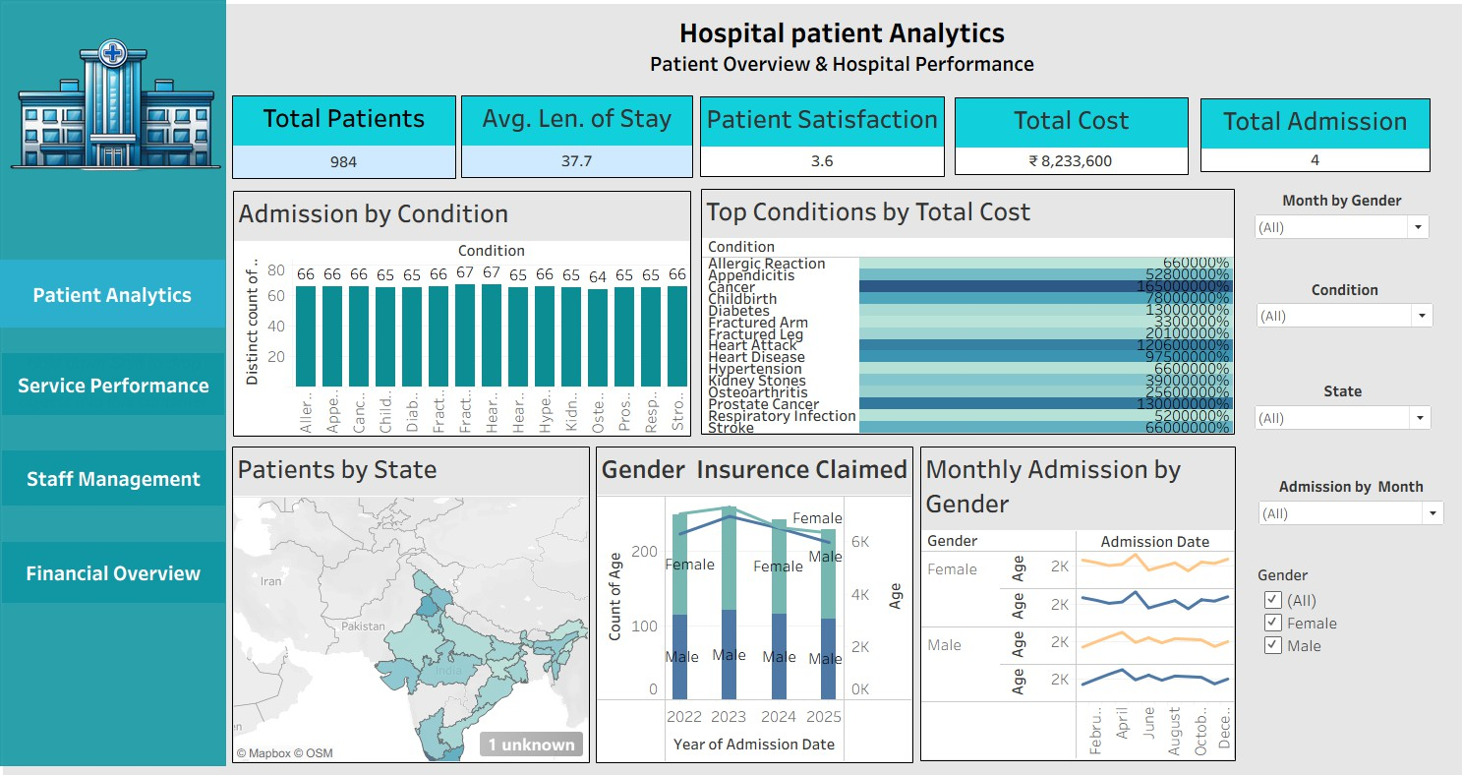
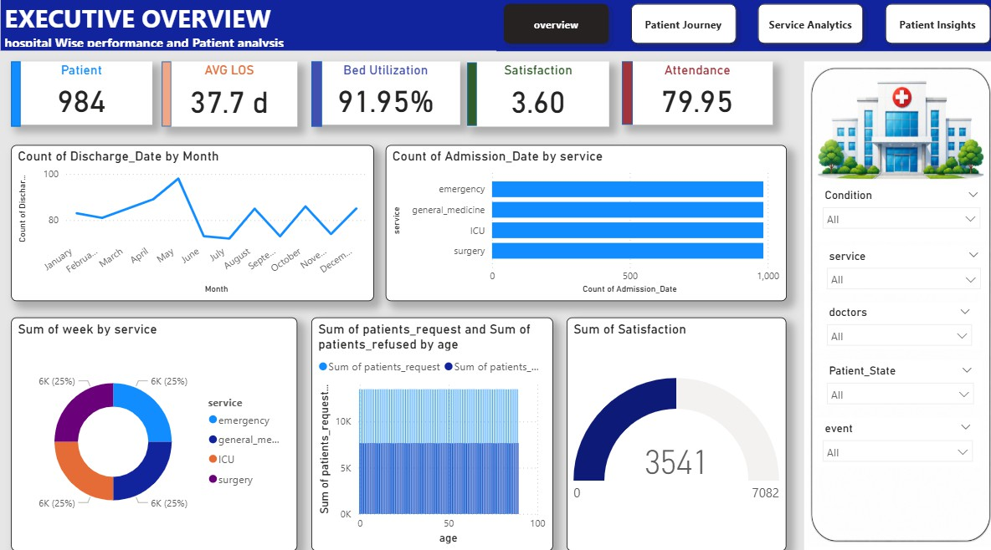
Patient Analytics Dashboard
D A S H B O A R D O U T P U T · 1 O F 4
KEY INSIGHT
984 total patients, 37.7-day average length of stay, and Cancer / Heart Attack identified as the costliest conditions to treat.

Slide 8

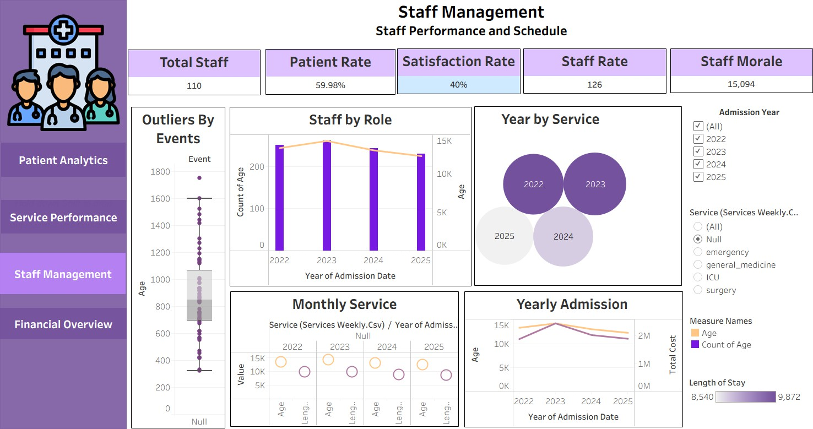
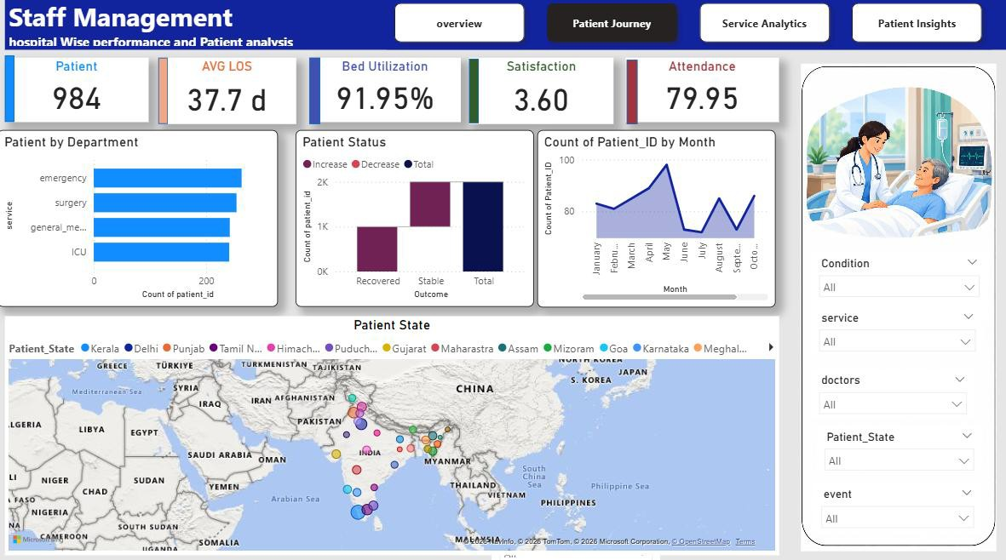
Staff Management & Service Analytics
D A S H B O A R D O U T P U T · 2 O F 4
KEY INSIGHT
110 staff members tracked across 4 departments, with service-level satisfaction and demand patterns compared side by side.

Slide 9

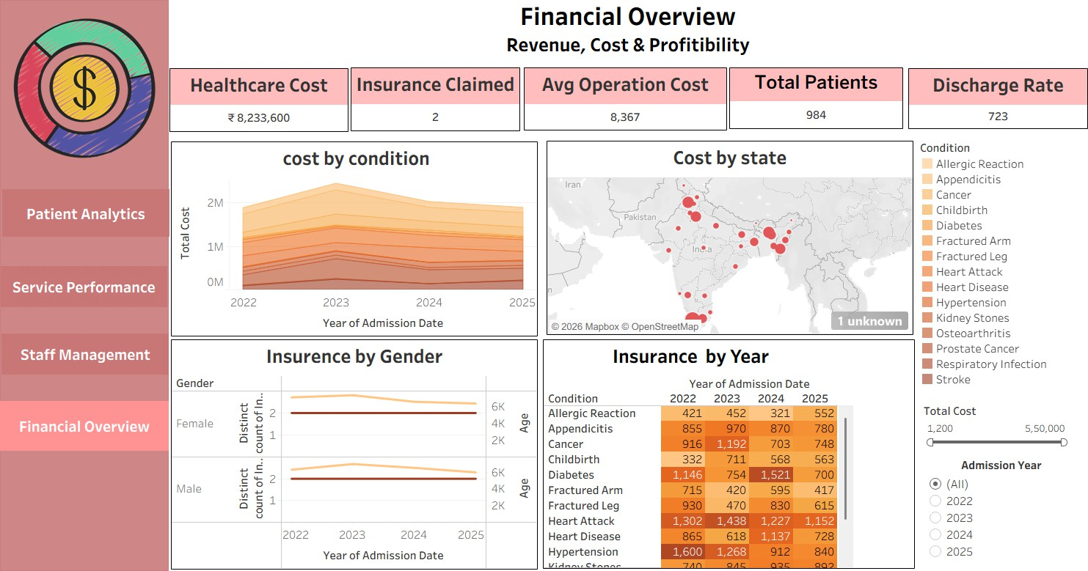
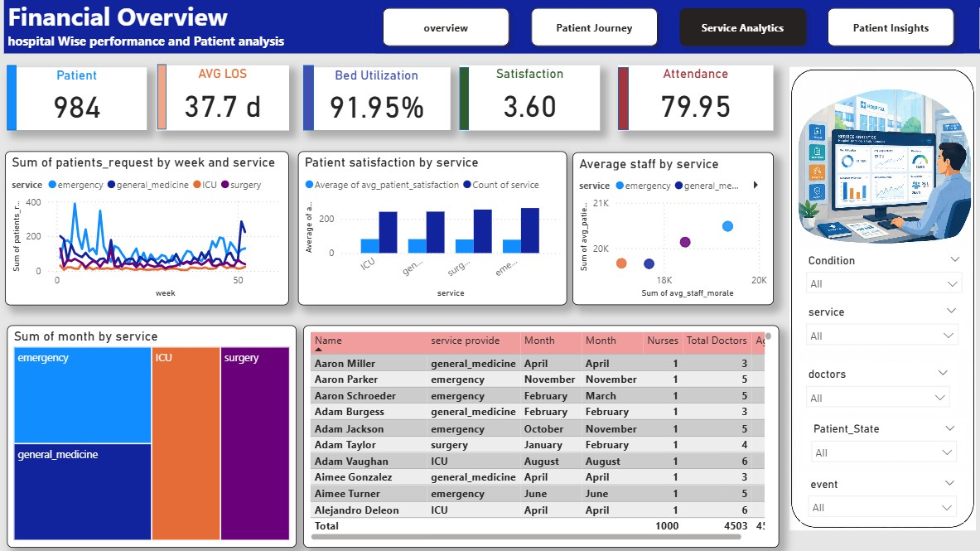
Financial Overview
D A S H B O A R D O U T P U T · 3 O F 4
KEY INSIGHT
₹8.2M+ in total healthcare cost, with Emergency running at 100% bed utilization — the tightest capacity of any department.

Slide 10
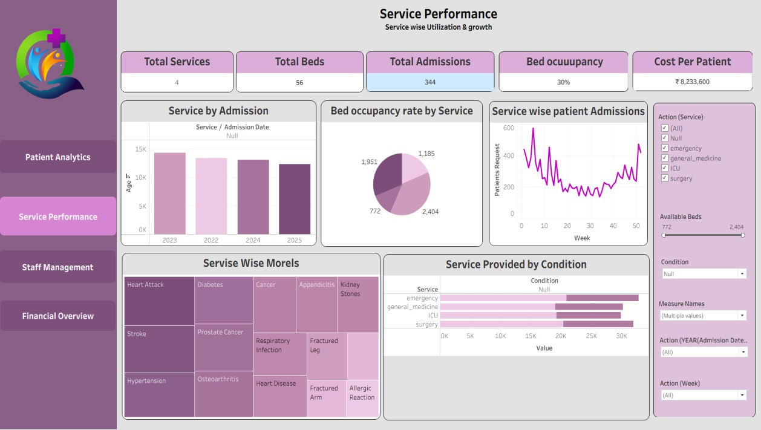
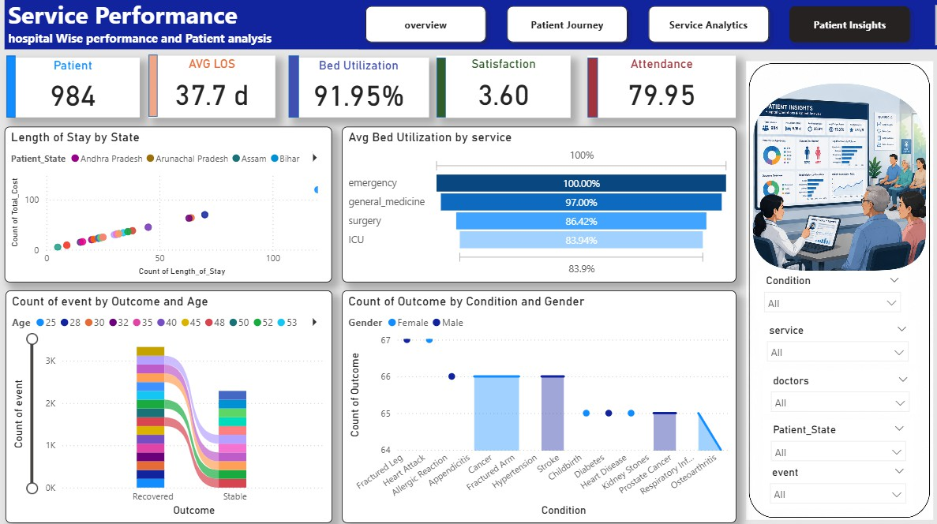
Service performance
D A S H B O A R D O U T P U T · 4 O F 4
KEY INSIGHT
110 staff members tracked across 4 departments, with service-level satisfaction and demand patterns compared side by side.

Slide 11
Hospital Analytics Dashboard
D A S H B O A R D 1 O F 4 — W I R E F R A M E P A G E 1
Gives clinicians and administrators one view of who is being treated, for what, and at what cost. Five KPI scorecards — Total Patients, Avg. Length of Stay, Patient Satisfaction, Total Cost and Total Admissions — anchor the page, backed by condition, geography and insurance breakdowns, all filterable by month, gender, condition and state.
KEY VISUALS USED
TOOLS & TECHNIQUES
Admission by Condition — vertical bar chart of patient volume per medical condition.
Top Conditions by Total Cost — horizontal highlight table; Cancer and
Heart Attack rank highest.
Patients by State — filled choropleth map of patient geography across India.
Gender Insurance Claimed — dual-axis bar + line chart, split by year (2022–2025).
Monthly Admission by Gender — small-multiple line charts comparing
seasonal patterns.
Tableau calculated fields — used to derive Total Cost and Length of Stay.
Tableau built-in geocoding — powers the Patients by State map with
no external shapefiles.
Interactive filters — Month, Gender, Condition and State slice every chart on the page.

Slide 12
Service Performance Dashboard
D A S H B O A R D 2 O F 4 — W I R E F R A M E P A G E 2
Tracks patient demand against capacity for each department — Emergency, General Medicine, ICU and Surgery. Weekly request trends sit alongside satisfaction and staffing-morale comparisons, so operations leads can see where requests are outpacing admissions and whether busier services are also the less satisfying ones.
KEY VISUALS USED
TOOLS & TECHNIQUES
Patient Requests by Week & Service — multi-line chart tracking weekly demand per department.
Patient Satisfaction by Service — combo bar + line comparing
satisfaction against volume.
Average Staff by Service — scatter plot of staff morale versus patient satisfaction.
Monthly Service Volume — treemap sizing each department's share of monthly activity.
Staff Roster Table — detailed matrix of names, services, months and
role counts.
Power BI scatter visuals — used to explore morale vs. satisfaction by department.
Power BI matrix/table — gives a drill-down view behind the summary
charts.
Slicers — Condition, Service, Doctors, Patient State and Event filter the page.

Slide 13
Staff Management Dashboard
D A S H B O A R D 3 O F 4 — W I R E F R A M E P A G E 3
Focuses on workforce scale, scheduling and wellbeing. Five scorecards — Total Staff, Patient Rate, Satisfaction Rate, Staff Rate and Staff Morale — summarize the workforce at a glance, backed by outlier detection and role/service breakdowns so under- or over-stretched teams stand out immediately.
KEY VISUALS USED
TOOLS & TECHNIQUES
Outliers by Events — box-and-whisker plot flagging unusual ages against event counts.
Staff by Role — combo bar + line tracking doctor/nurse counts, 2022–
2025.
Year by Service — packed bubble chart comparing yearly activity volume.
Monthly Service — dot-matrix cross-tab of month against year, per department.
Yearly Admission — dual-axis line chart plotting age against total cost
over time.
Tableau box-and-whisker plots — used to detect outlier ages tied to unusual event counts.
Tableau packed bubble charts — compare year-by-service activity
volume at a glance.
Filters — Admission Year, Service and a Length-of-Stay range slider.

Slide 14
Financial Overview Dashboard
D A S H B O A R D 4 O F 4 — W I R E F R A M E P A G E 4
Gives the finance view of the same patient population — total healthcare cost, insurance claims, average operation cost and discharge rate — broken down by condition, state, gender and year, so cost-control efforts can be targeted at the conditions and regions driving the most spend.
KEY VISUALS USED
TOOLS & TECHNIQUES
Cost by Condition — stacked area chart tracking cumulative cost, 2022–2025.
Cost by State — proportional-symbol bubble map sized by total
treatment cost.
Insurance by Gender — dual-line chart comparing claim trends, female vs. male.
Insurance by Year — heat-map cross-tab; Heart Attack and Diabetes claim the most.
Tableau proportional-symbol maps — used for the Cost by State visual.
Tableau highlight tables — heat-map shading surfaces the highest-
claim cells.
Filters — Condition checklist, Total Cost range slider, Admission Year.

Slide 15

Key Takeaways
W R A P P I N G U P
5 datasets → 1 dataset
6+ KPIs engineered
Consolidated fragmented hospital files into a single, analysis-ready 1,000 × 20 table.
Admissions, LOS, Bed Utilization, Occupancy and Readmission Rate calculated and validated.
4-page dashboard suite
Actionable insights
Delivered independently in both Tableau and Power BI, fully filter-linked.
Cost drivers, capacity pressure points and staffing patterns surfaced for administrators.
10

Slide 16


